Slide 1
Predicting Article Shares Within The Digital Marketing Industry

Slide 2
Problem Statement + Why?
Problem: Content creation is expensive and time consuming.
Why: Article data is segmented and hasn’t been aggregated for analysing the performance of individual articles:
Platforms: (backlink providers, content analytics platforms).
HTML: the web page itself (article).
Influencers: (social media posting + sharing).
Notes:
Creating articles requires a considerable time investment.
By predicting how many article shares an article will receive we can help marketers produce more shareable, effective content.

Slide 3
Goals + Success Metrics
Primary goal: To predict the number of shares an article will earn after being published for a minimum of 1 year on the internet.
Success Metrics:
To identify 3 - 5 core components that marketers can leverage to improve the shareability of their articles.
To improve the score of a range of machine learning models by combining 3 unique datasets with the URL as a common key.

Slide 4
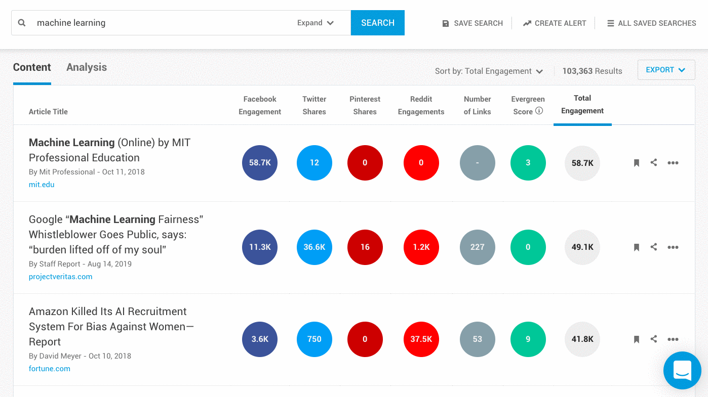
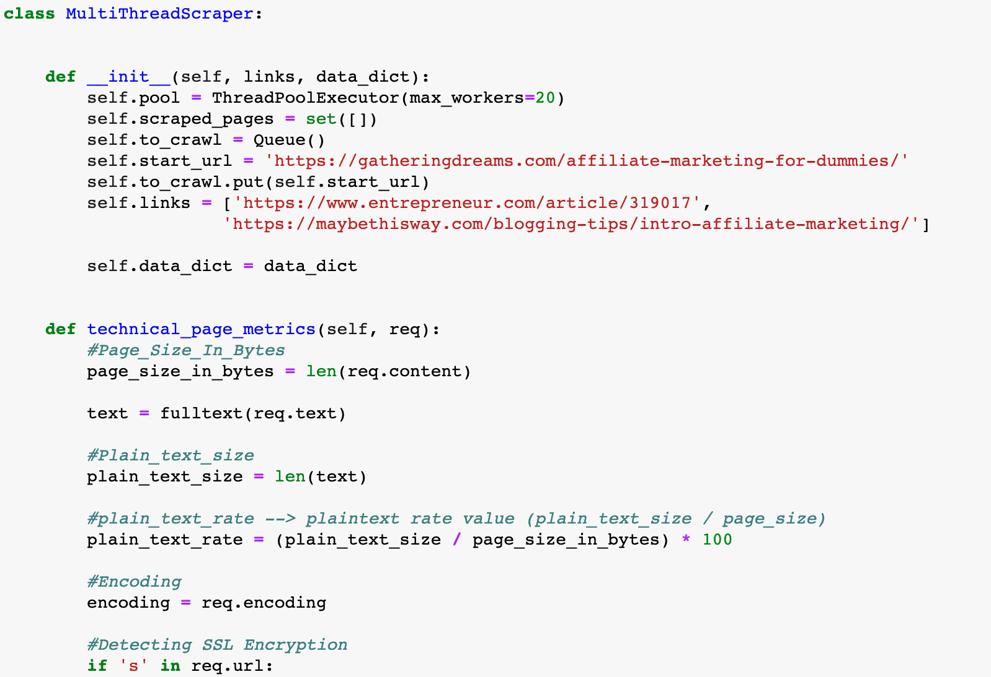

Three Data Sources
BuzzSumo + Web Scraping + Page Speed Data
1.
2.
3.
Notes:
In my project, I used three data sources:
Data from the content analysing platform BuzzSumo - 15 topics were downloaded from BuzzSumo's pro plan, the topics were selected by performing keyword research in Ahrefs. The keywords with the largest monthly search volume were selected to be topics.
A custom web crawler was created that allowed for the extraction of unique features from the article text, HTML content.
Google's PageSpeed API was utilised to extract page speed metrics for every article.

Slide 5
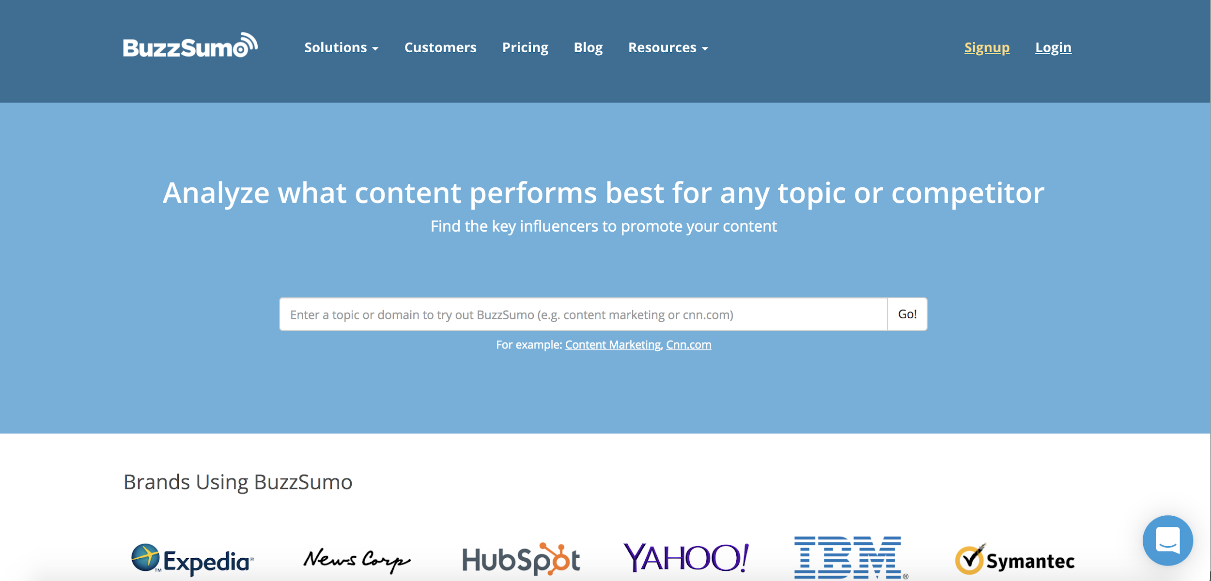
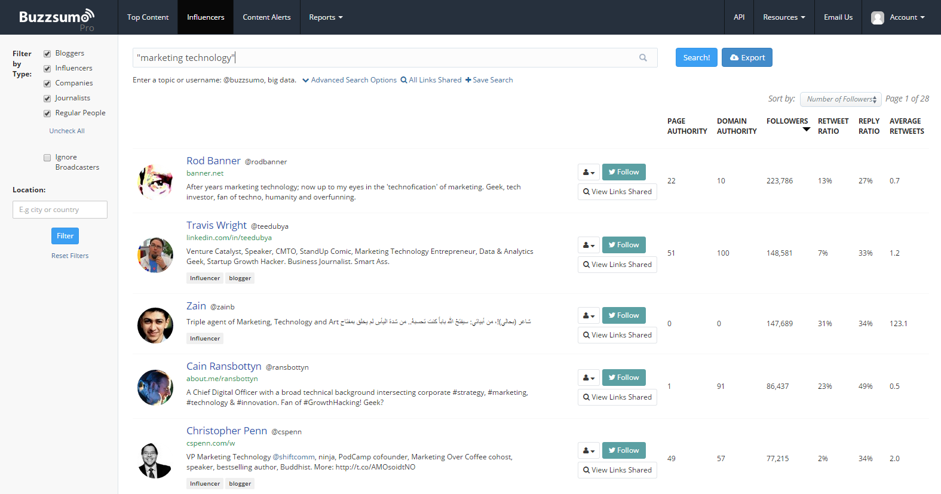
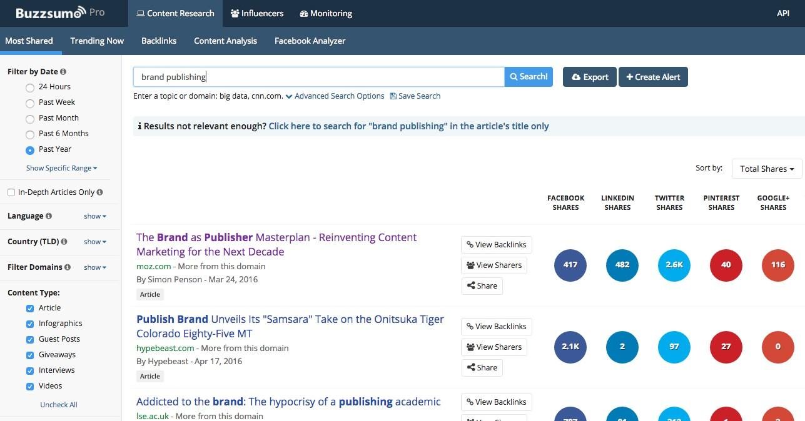
What Is BuzzSumo?

Slide 6
Overall Approach
1. Data Collection - BuzzSumo Topic Data
17 topics were included:
Affiliate Marketing, Content Marketing, Copywriting, Display Advertising, Email Marketing, Growth Hacking, Influencer Marketing, Link Building, Marketing Automation, Podcast Marketing, Search Engine Marketing, Social Media Marketing, Video Marketing, Website Design.
A custom web crawler was created that allowed for the extraction of 61 metrics including the article text, HTML content.
Google's PageSpeed API was utilised to extract page speed metrics for every article.
Notes:
Put the date in for when buzzsumo snapshot was taken

Slide 7

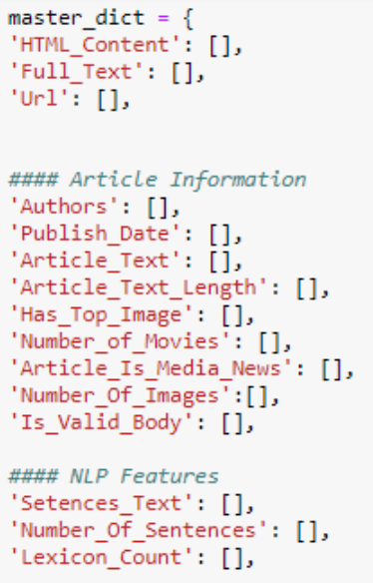
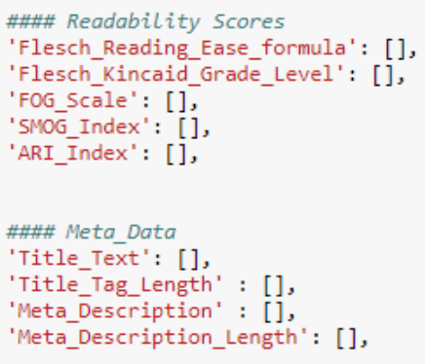
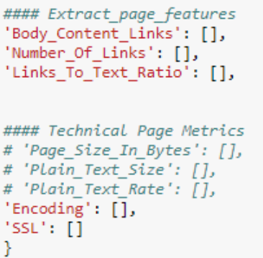
Overall Approach
1. Data Collection - Web Scraping
Notes:
Afterwards we created a data structure for the Python Web Crawler which would enable us to extract important features from the scraped articles.
The types of features that were extracted included:
Article Information:
Were there any authors?
The article text!
The number of images within the article.
NLP Features:
Sentence Text
Number of Sentences
Lexicon count - The number of unique words per article text.
On-Page Word Metrics (Word Count, Unique Word Count, Number of Sentences).
Technical On-Page Metrics (Page Load Speed, No SSL/SSL etc).
Additionally a range of readability scores were calculated for every article.

Slide 8
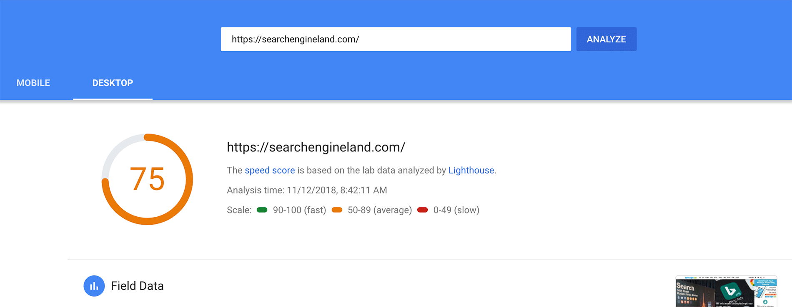
Overall Approach
1. Data Collection - PageSpeed Insights

Slide 9



Overall Approach
2. Data Cleaning Architecture
Data Sources
Data Cleaning
Feature Engineering

Slide 10
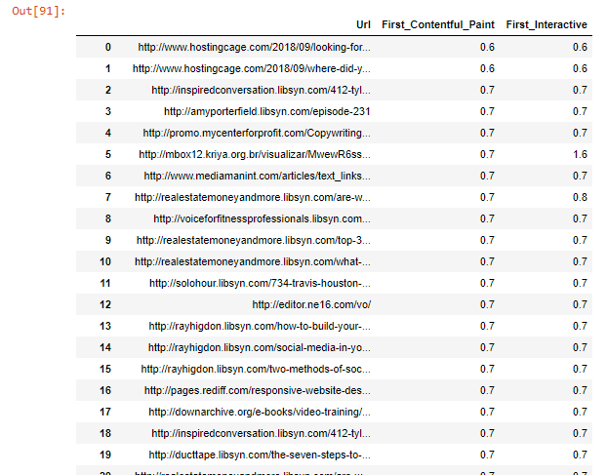
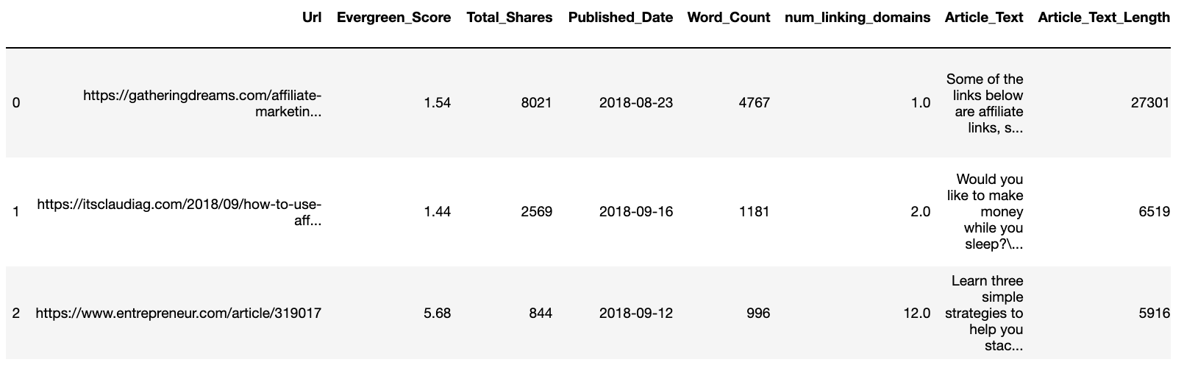
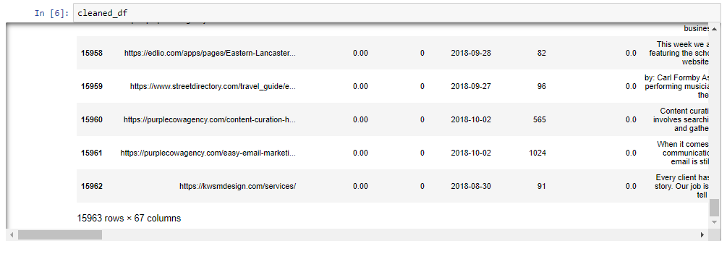
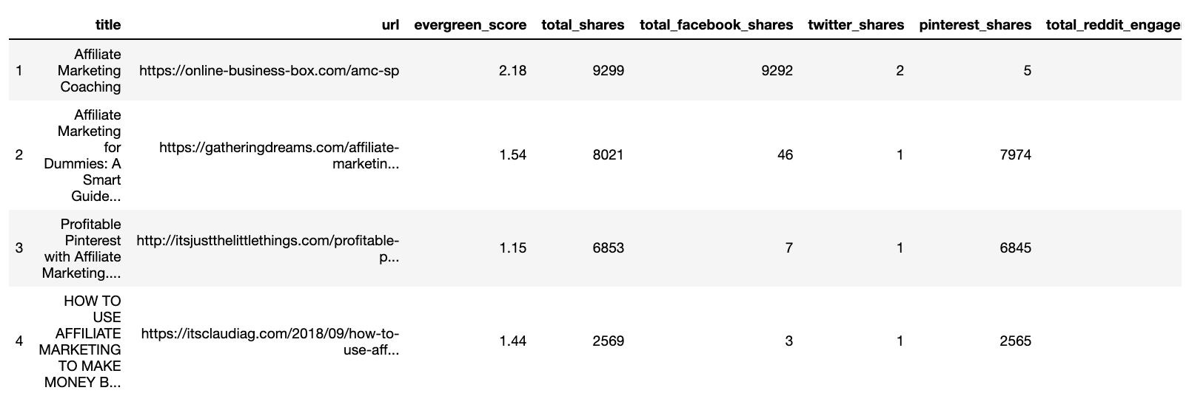
Overall Approach
3. Dataset Merging + Munging
Notes:
30,000 BuzzSumo Records - 29 columns
15963 rows × 67 columns
Web Page Data
Final DataFrame - 14469 x 69 columns

Slide 11
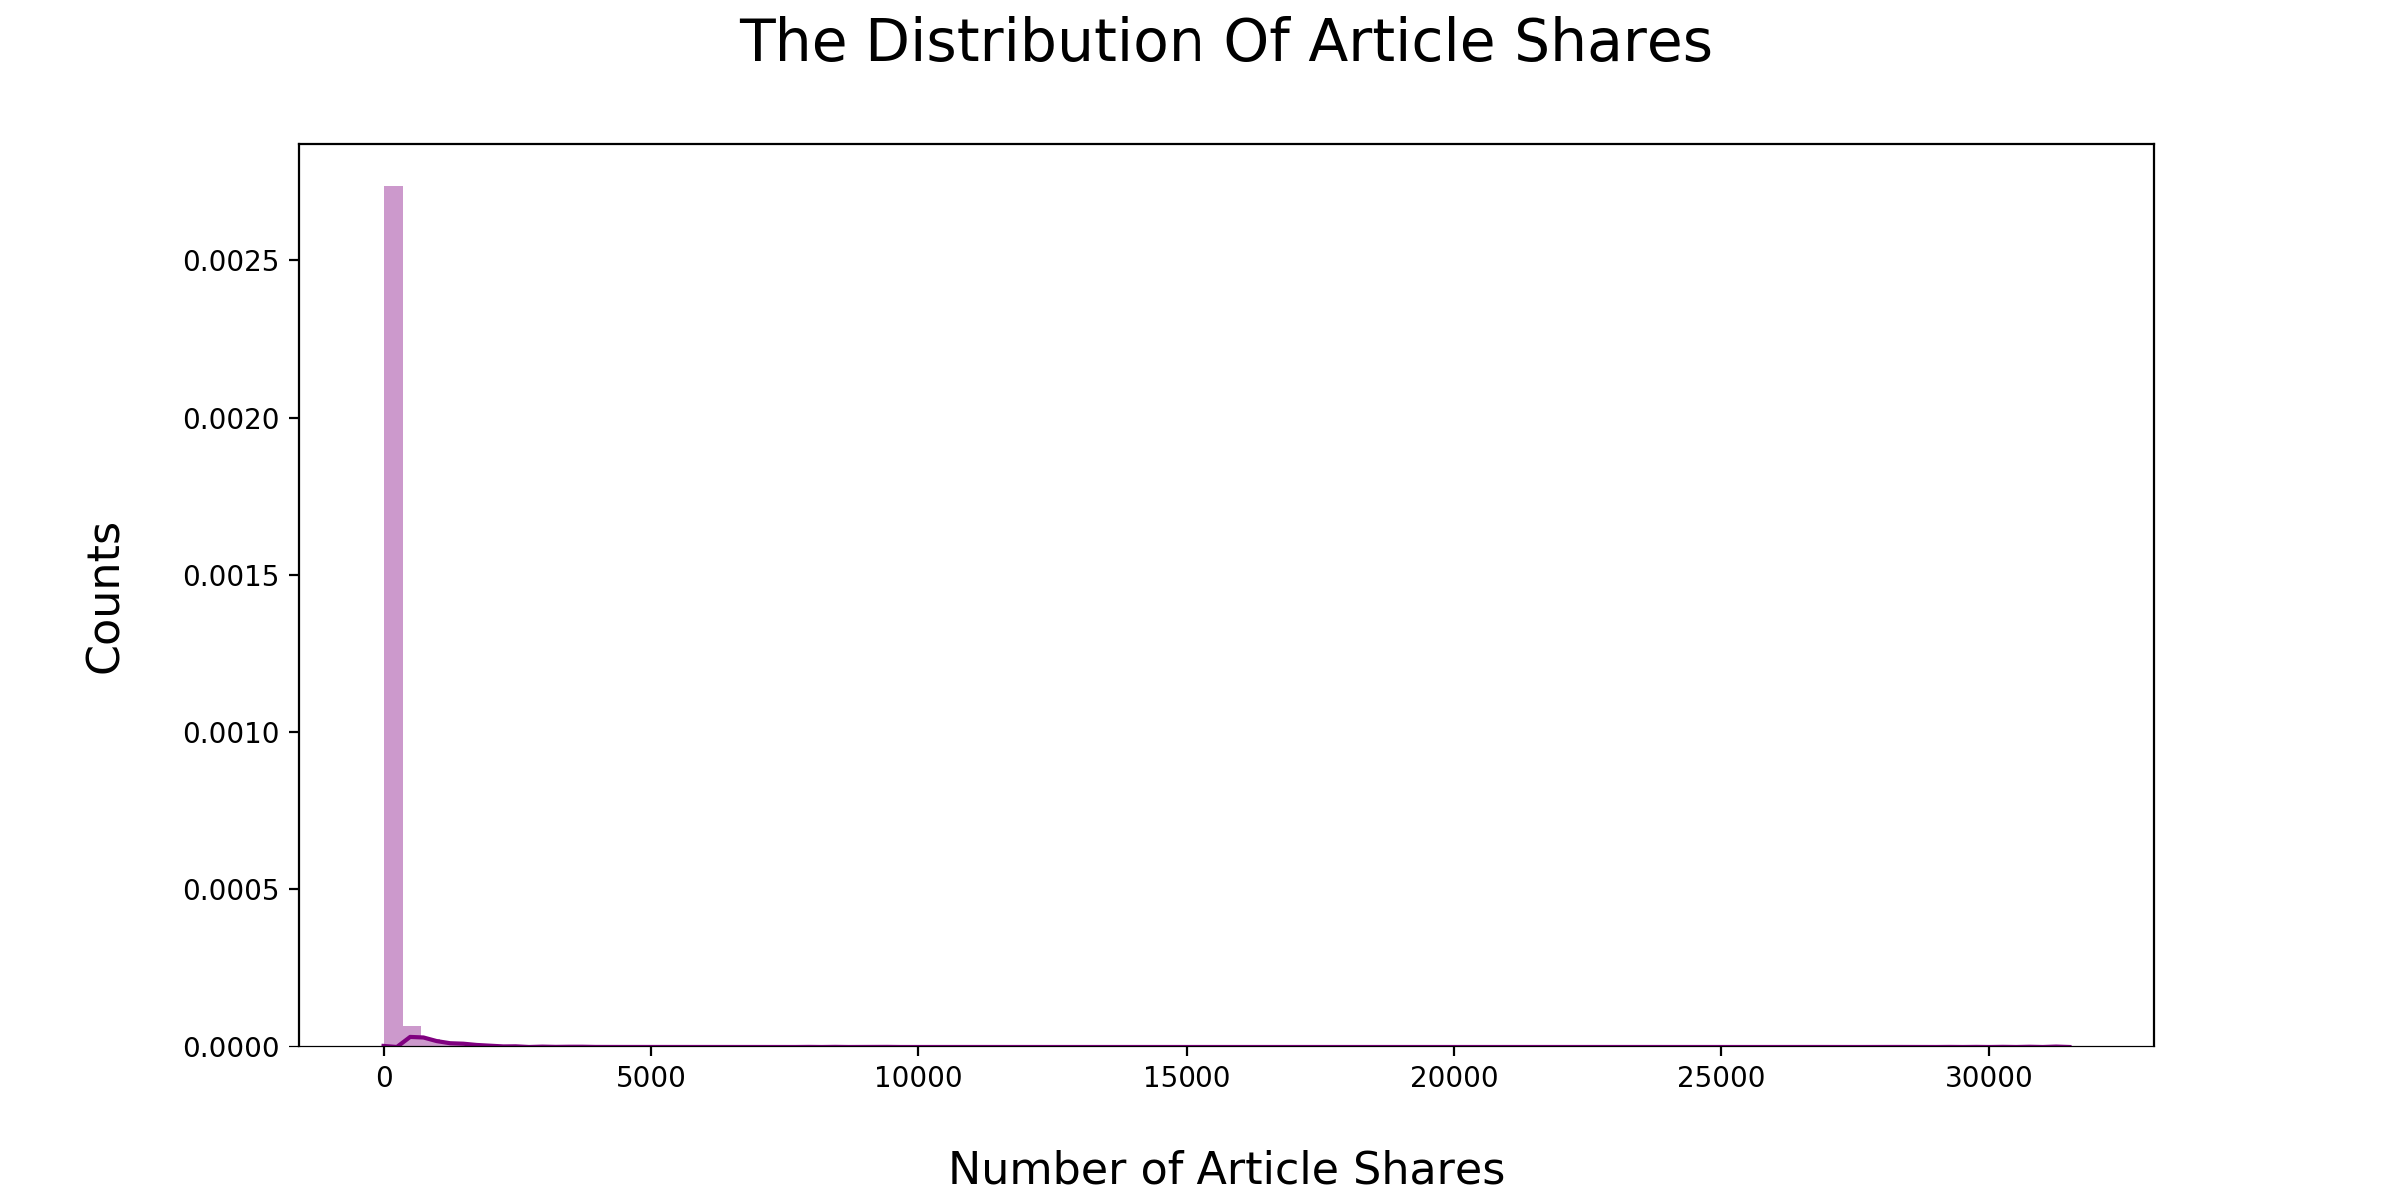
EDA
1. Target Variable Distribution
Notes:
Our target variable Number of Article Shares is highly skewed and is likely to be an exponential distribution.
Not normally distributed.

Slide 12
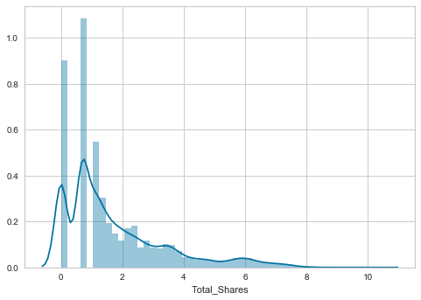
EDA - Applying a Np.log + 1 Transformation
Notes:
This is what the target variable looked like after applying log + 1 on the target variable.

Slide 13
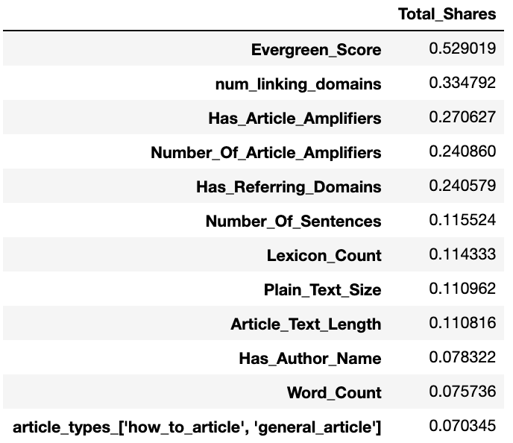
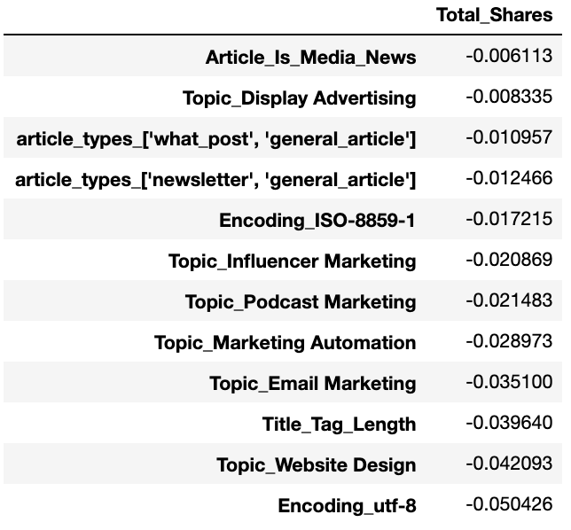
EDA
Notes:
In terms of correlation:
On the left we can see what variables are most positively correlated with our target variable.
Evergreen Score.
Number of Linking Domains.
Whether the Article Has An Article Amplifier.
On the right, there were not many strong negative correlations.

Slide 14
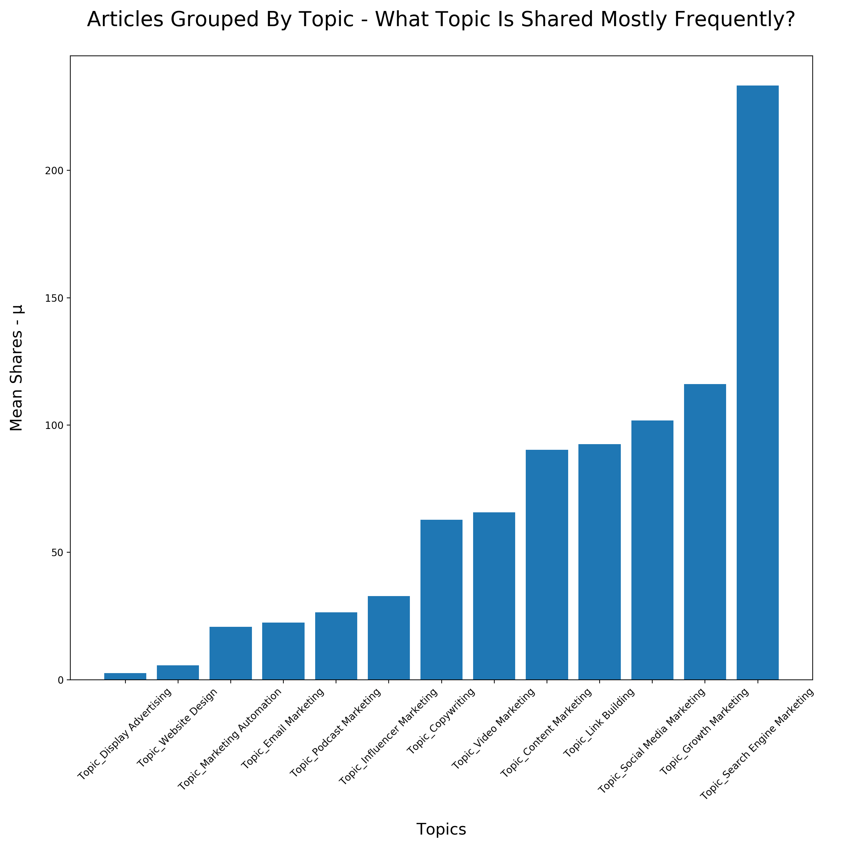
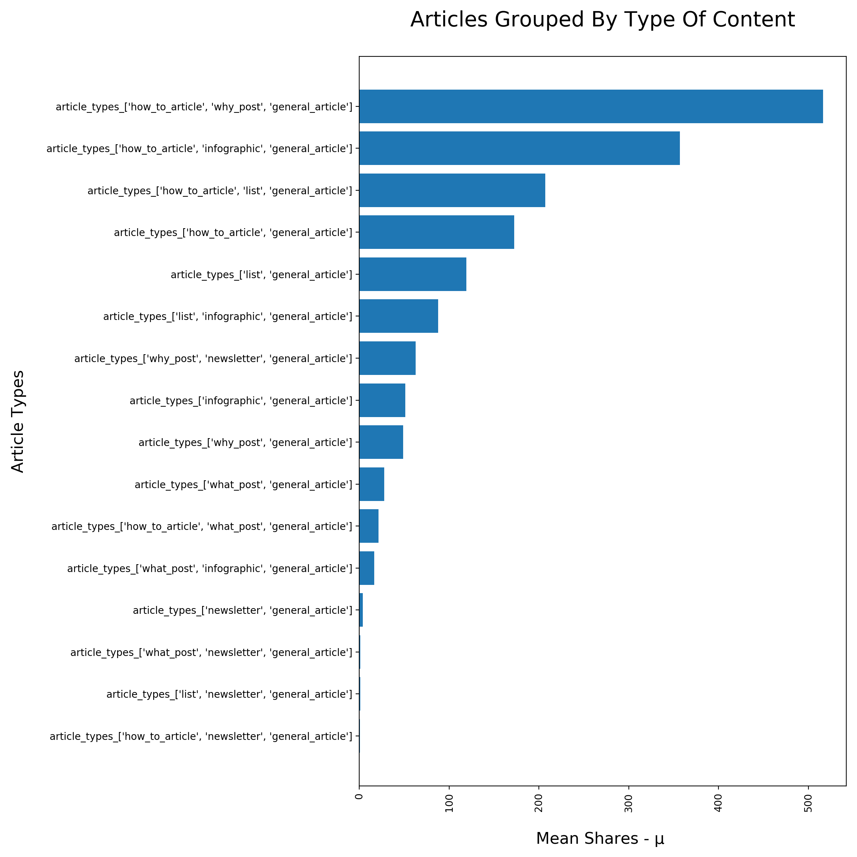
EDA
Notes:
Articles that are tagged "how to articles" & "why post" on average received the most amount of shares, this was followed by infographics and list articles.
Therefore the insight that we can gain from this is that people reading digital marketing topics share on average content that is:
educational (how to)
visual (infographic)
and easily digestible (list articles).
The most popular topics in terms of mean shares were: Search Engine Marketing, Growth Marketing & Social Media Marketing.

Slide 15
Modeling
1. What Models Were Implemented?
Linear Regression
LassoCV, RidgeCV (modified versions of linear regression)
Decision Trees, Random Forests
Support Vector Machine

Slide 16
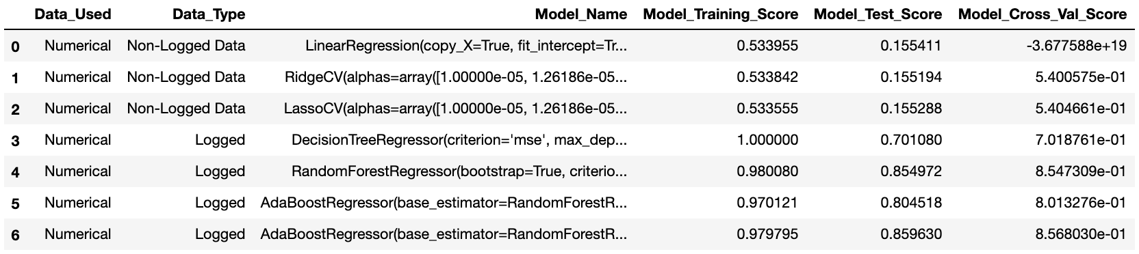
Modeling
2. Results Summary
Notes:
The most impactful model was as a logged target variable, with 5 bagged forest random regressor's which served as the base estimator for the AdaBoostRegressor model.
Additionally by adding the web page speed data from Google Page Speed Insights, the mean cross validation score increased on our best model by ~ 5%.

Slide 17
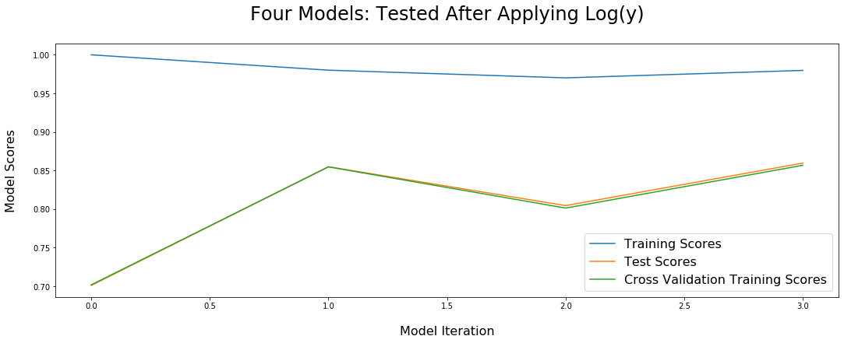
Modeling
2. Results Summary
Notes:
Decision Tree
Randomforest
Ada Boosted Random Forest
Ada Boosted Random Forest + Web Page Speed Data (Gained an additional 5% in score from including this).

Slide 18
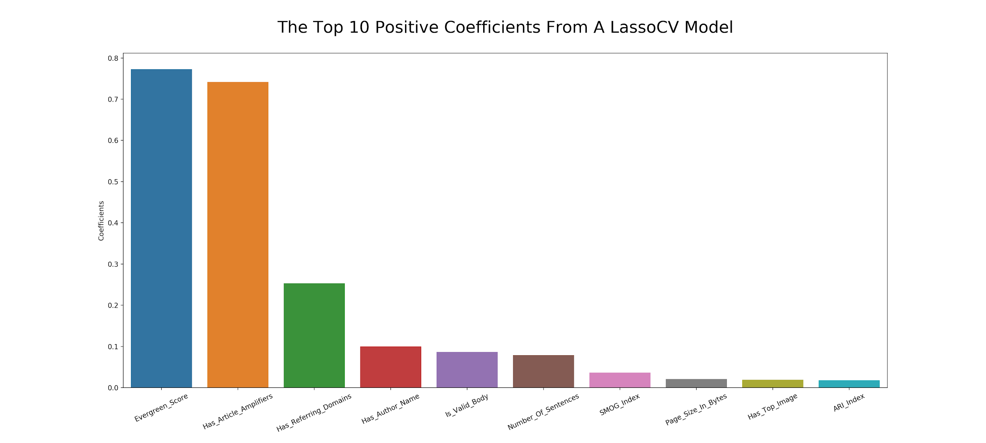
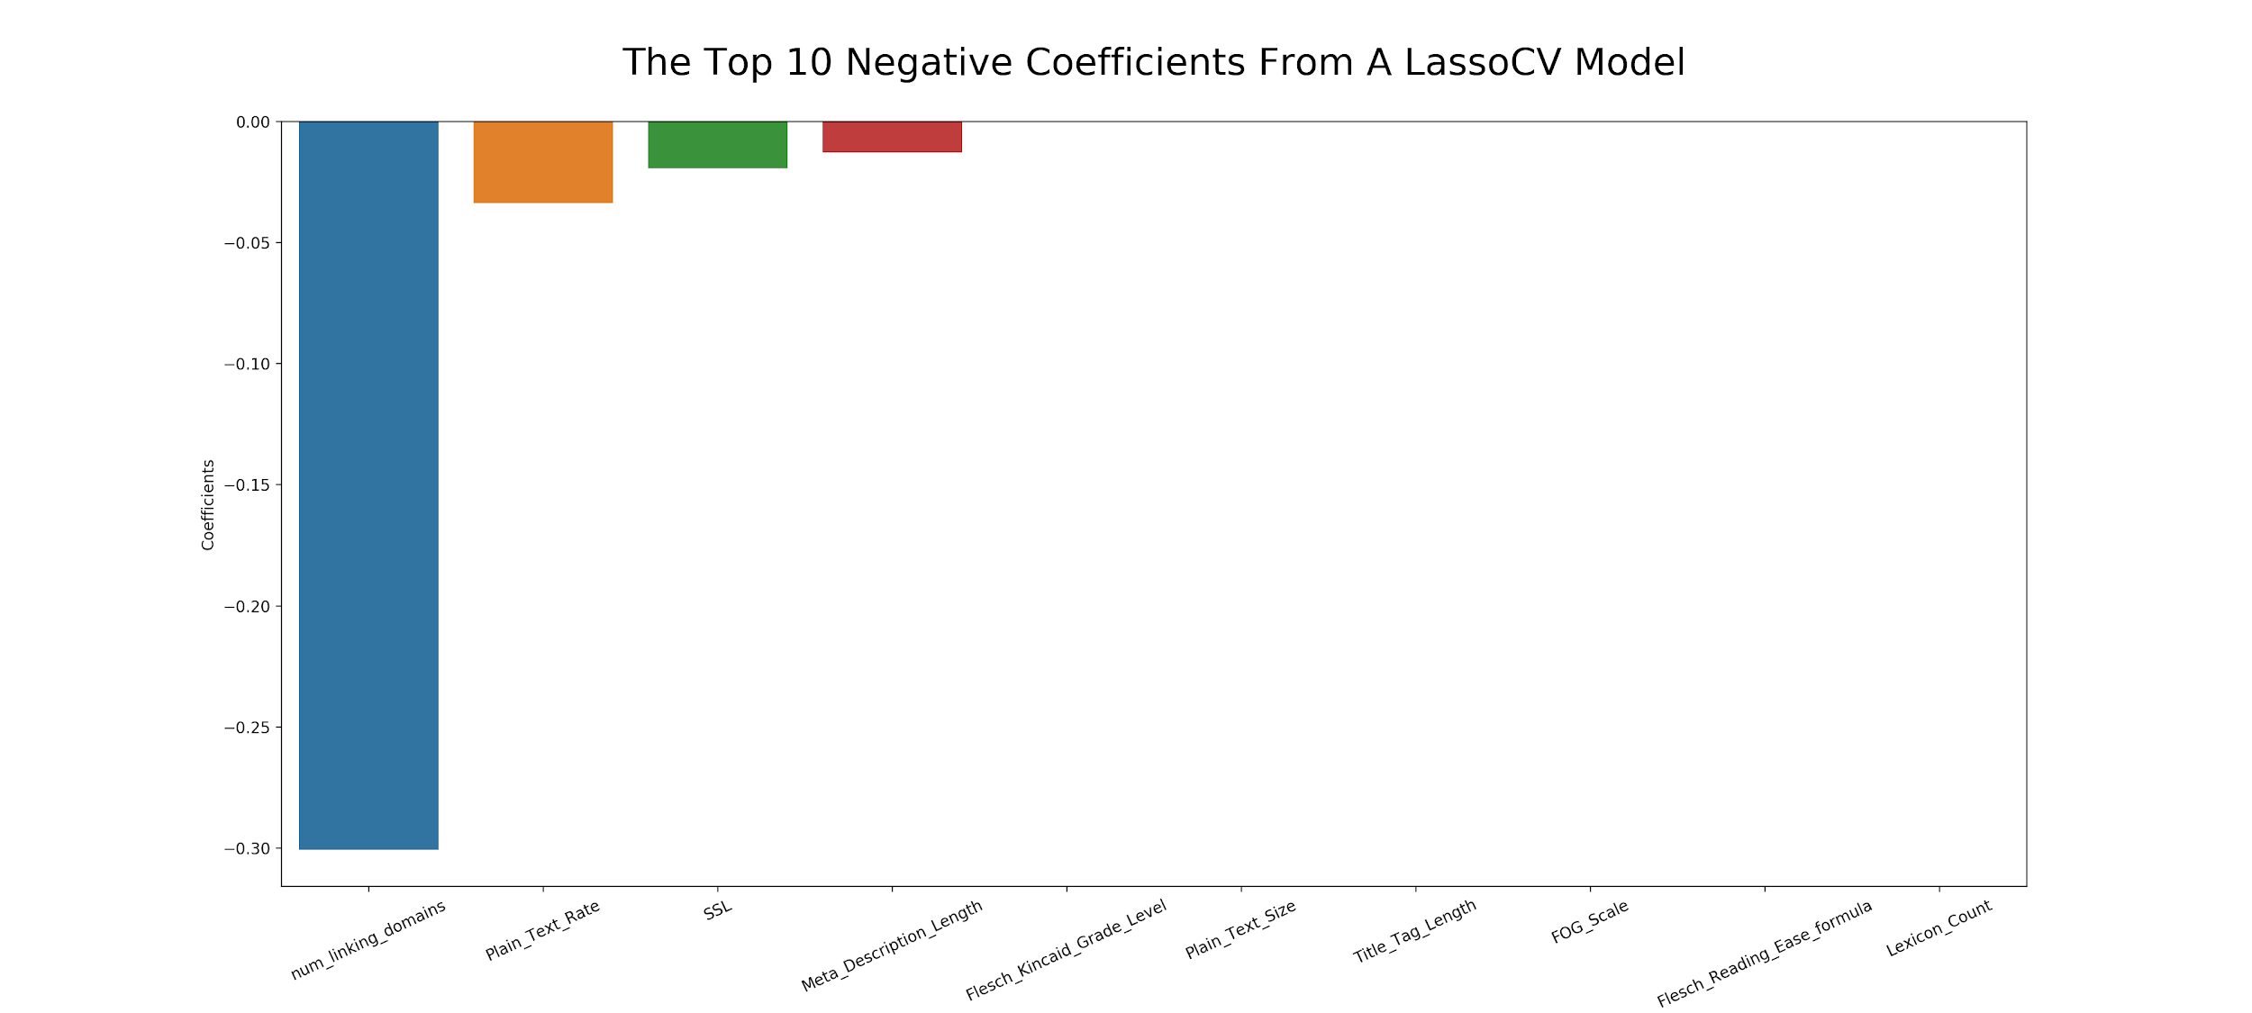
Modeling - LassoCV
2. Results / Findings

Slide 19
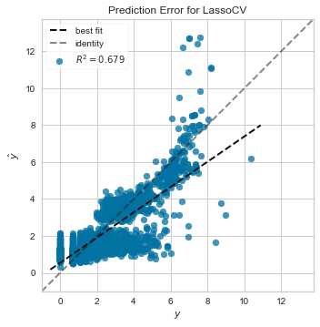
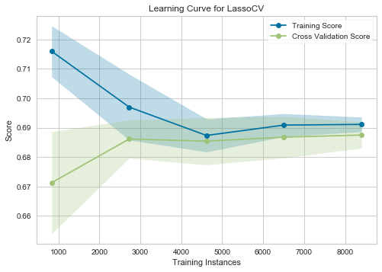
Modeling - LassoCV
Notes:
The learning curve shows us how many training observations we need to reduce the variability/standard deviation of the mean training score and the cross validation score.
After ~ 4500 observations the training score and cross validation score start to convergence which shows us that we only need ~4500 observations to start making stable predictions.

Slide 20
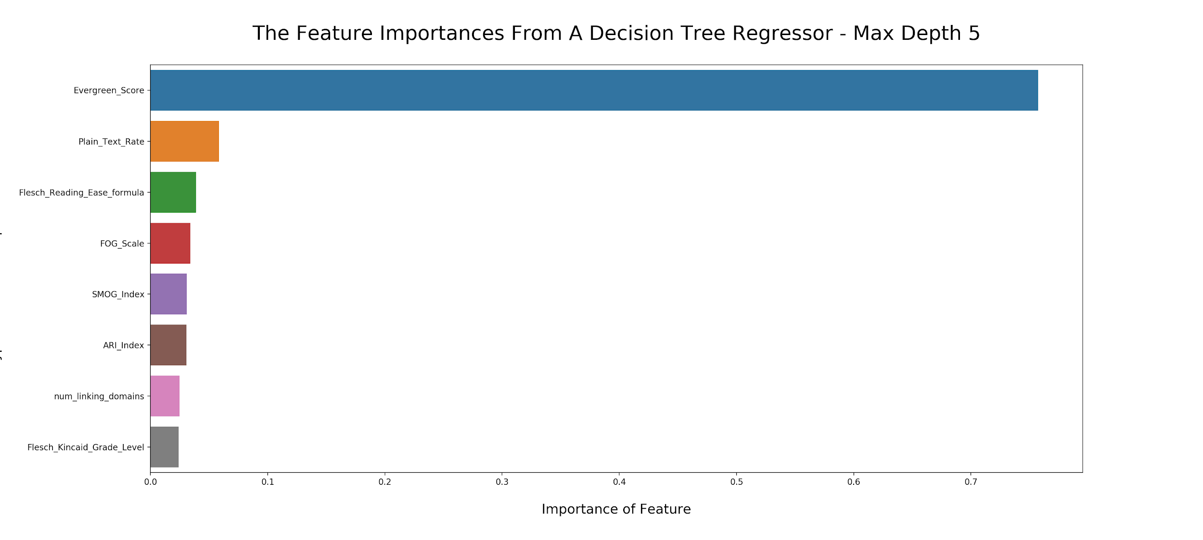
Modeling - Decision Tree Regressor
Notes:
In order to simply look at the feature importances, I decided to use a max -depth 5 decision tree instead of a random forest.
Firstly the evergreen score is a calculated metric within BuzzSumo and is meant to dictate ‘how evergreen’ a piece of content is.
The number of linking domains is how many do-follow backlinks are pointing at the article.
The most important features in determining the log value of y are:
Evergreen Score
The Number of Linking Domains
Readability Scores
Plain_Text_Rate

Slide 21
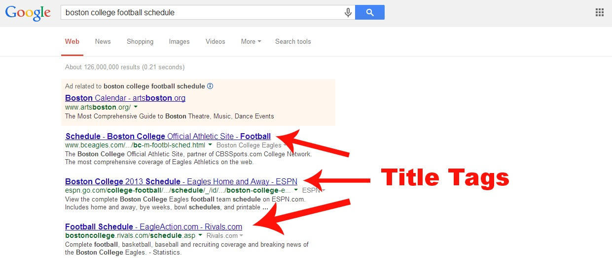
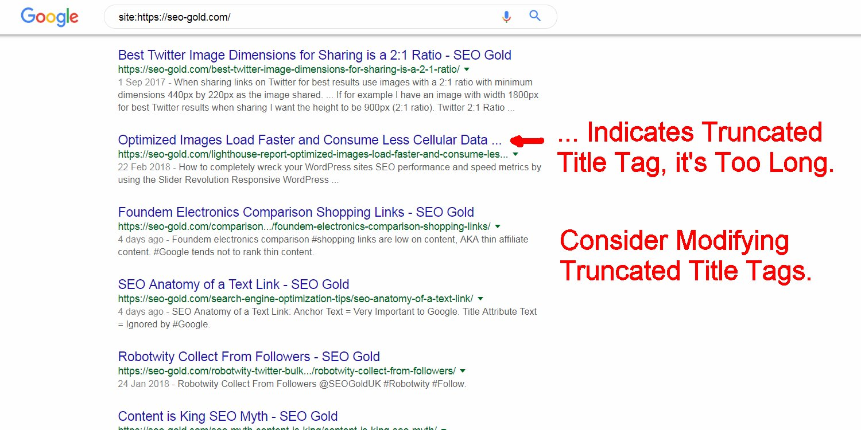
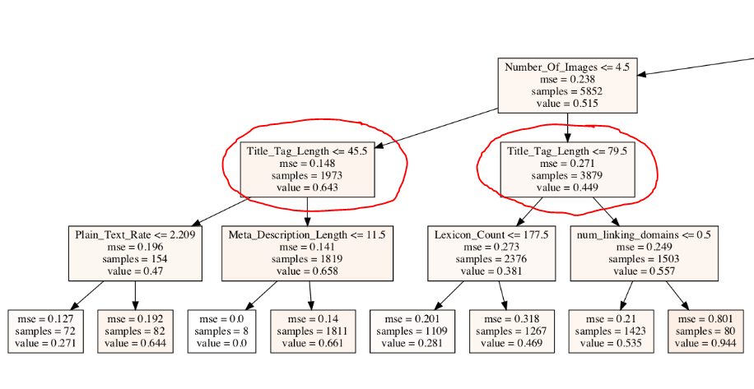
Modeling - Decision Tree Regressor
Notes:
Additionally for articles that had more than 0.5 article amplifiers and a higher evergreen score than 0.155:
5852/12594 samples were divided by the Title_Tag_Length and an example of this can be seen below.
We can infer from this that having a title_tag_length > 79.5 characters causes an article to become less shareable and also if the title_tag_length is less than 45.5 the article is also less likely to be shared.
This makes sense because we want a catchy, strong headline that entices someone to click and read the article.
However if the article headline is too long then it will cause the title to be truncated within the Google SERPS (search engine results pages) which often leads to a lower click through rate for the article.

Slide 22
Risks / Limitations
Sample Selection / Omission Bias.
The Newspaper3k python library.
The data snapshot consists of a two month segment where:
All of the articles are 1+ years old.
15 topics were selected to cover the digital marketing industry publishing space.
NLP (Investigating using Spacy)
Notes:
Omission Bias: Only selecting mature websites will almost certainly impact the 'shareability' - this means that the model could potentially be over-/under-estimating the effects of certain factors because this factor is not properly controlled for or included in the model.
The sample that we chose was 1 year old, this was selected to remove any bias of an article not being online enough to receive a significant part of it's online shares. However this type of sample could lead to bias within the model's predictions. Therefore it would be advisable to study the natural share cycle of article's and the share velocity from when an article is originally published until it reaches a certain level of maturity.
The Newspaper3k python library was only able to collect 15,000 articles from the original 30k dataset. Therefore these had to be discarded.

Slide 23
Assumptions
Is a one month sample, representative of the total article shares that would be found in the true population?
Seasonality or consumer trends / times during the year have not been considered and have little impact on article shareability.
Notes:
Seasonality might have an influential factor on how article's are shared across different topics.
There is a lagged component that hasn’t been included in the model. (i.e. article’s receive shares over a series of months. Not as a given snapshot).
By not taking into account the time component, can lead to spurious relationships (i.e. if x and y variables increase over time the model could tell us that there is a strong relationship but actually both could be independant and an another variable could be driving the relationship as a confounding factor.

Slide 24
Next Steps
Sentiment analysis.
Scrape additional topics & monitor topics over time.
RNN (LSTM) Neural Network implementation + Time Series Models
To scrape additional link metrics from 3rd party providers including:
Ahrefs
SEMrush
Majestic
Notes:
Perform a sentiment analysis over time.
Seasonality might have an influential factor on how article's are shared across different topics.
To model the data on a neural network as from having to apply a logarithm to the target variable we can clearly see that the relationship is less linear with the original target variable scale. A neural network might be more able to model the non-linear relationships between the predictor matrix and the target variable.
Using a time-series model with the original features as additional features (exogenous features).
It would also be good idea to track articles / topics for several months or years. This would allow us to perform time series analysis on individual topics.

Slide 25
Conclusion
Ada Boosted RandomForestRegressor was the best performing model.
Taking the logarithm of the target variable (Total_‘Article_Shares’) helped to improve the model scores by creating a more linear relationship between our predictor features and ‘Total_Article_Shares’.
Notes:
Include a business conclusion:
30 - 60 elevator pitch (so what conclusion / answer).

Slide 26
Key Takeaways
Focus on producing more evergreen content.
Prioritise creating how to guides over infographics and list posts.
Leverage relationships with key influencers to increase the number of article shares.
Focus on long-form content as this was a positive coefficient in the LassoCV model (higher number of sentences).

